Slide 1

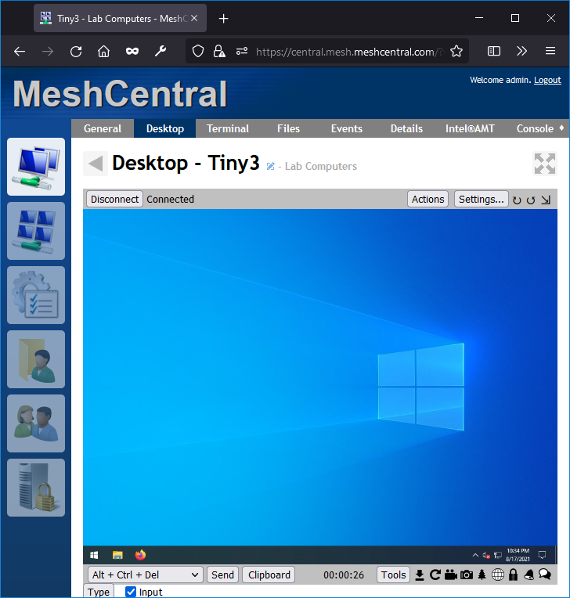

MeshCentral
Control
Channels
Tunnel
Agent

Slide 2
MeshCentral
Web Sockets
MeshRelay.ashx
Agent

Slide 3

MeshCentral
MeshRelay.ashx
Agent

Slide 4
MeshCentral v1
BAD
Tunnel is within the control connections
Agent

Slide 5
MeshCentral
MeshRelay.ashx
String + Binary Data
Agent
WebRTC

Slide 6
MeshCentral
Desktop
Multiplexor
Agent

Slide 7
MeshCentral
LAN or Hybrid Mode
LocalRelay.ashx

